Slide 1
Sorting Algorithms
Muhammad Abdulkariim

Slide 2
Introduction to Sorting Algorithms
Definition: Sorting algorithms are methods to rearrange elements in a list or array in a specific order (ascending or descending).
Importance: Used in databases, search algorithms, and data processing.
Common Sorting Algorithms: Bubble Sort, Selection Sort, Insertion Sort, Merge Sort, Quick Sort, etc.

Slide 3
Bubble Sort
Approach:
Compare adjacent elements and swap if they are in the wrong order.
Repeat until the list is sorted.
Time Complexity:
Best Case: O(n) (already sorted)
Average Case: O(n²)
Worst Case: O(n²)
Space Complexity: O(1) (in-place sorting)

Slide 4
Bubble Sort

Slide 5
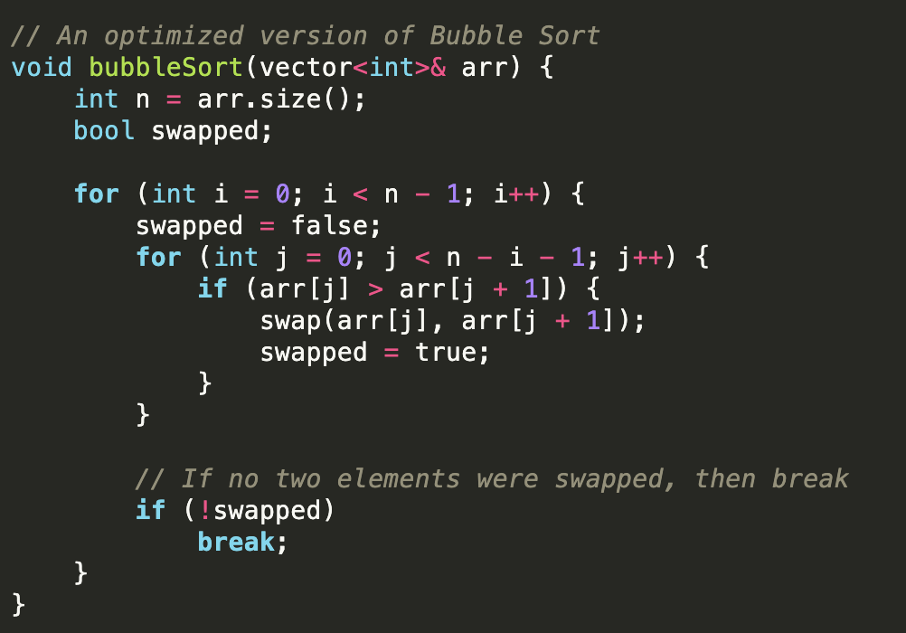
Bubble Sort

Slide 6
Selection Sort
Approach:
Divide the list into sorted and unsorted parts.
Repeatedly select the smallest (or largest) element from the unsorted part and swap it with the first unsorted element.
Time Complexity:
Best Case: O(n²)
Average Case: O(n²)
Worst Case: O(n²)
Space Complexity: O(1) (in-place sorting)

Slide 7
Selection Sort

Slide 8
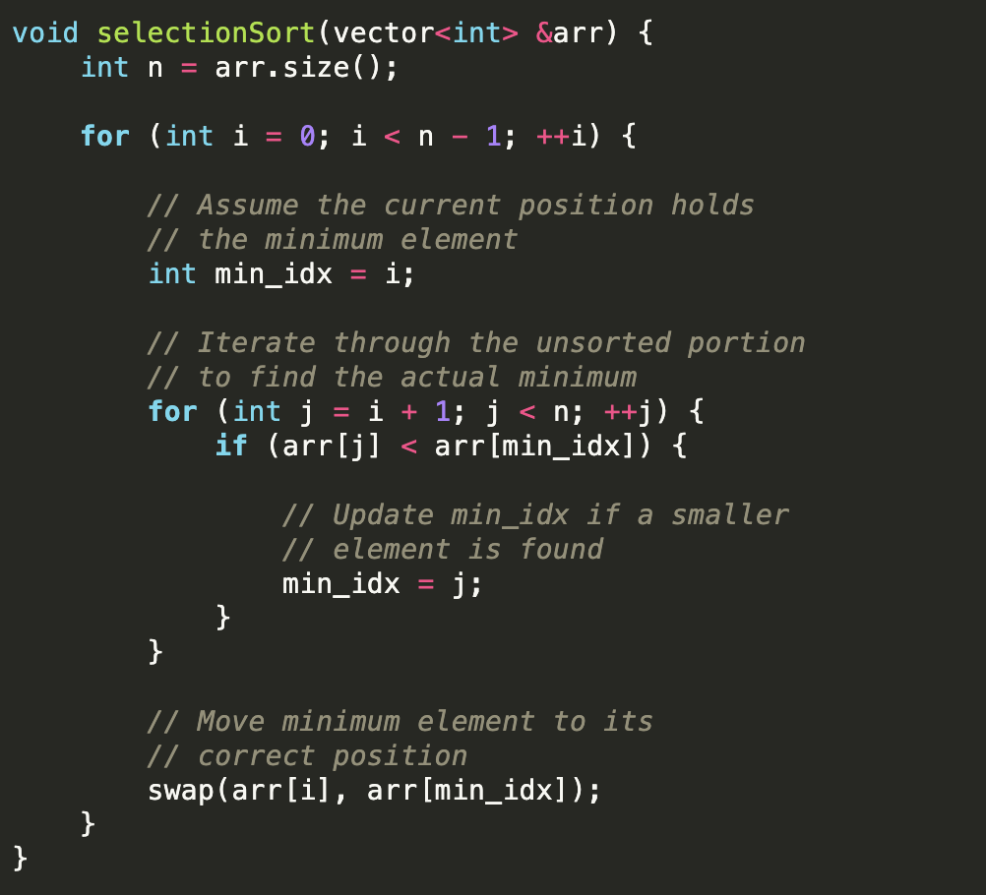
Selection Sort

Slide 9
Insertion Sort
Approach:
Build the sorted list one element at a time.
Take each element and insert it into its correct position in the sorted part of the list.
Time Complexity:
Best Case: O(n) (already sorted)
Average Case: O(n²)
Worst Case: O(n²)
Space Complexity: O(1) (in-place sorting)

Slide 10
Insertion Sort

Slide 11
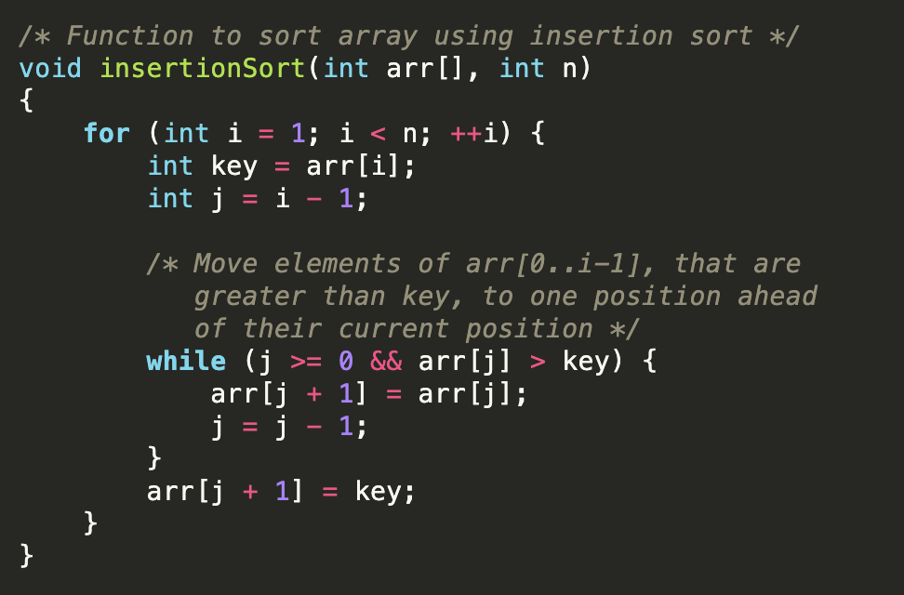
Insertion Sort

Slide 12
Merge Sort
Approach:
Divide the list into two halves.
Recursively sort each half.
Merge the two sorted halves.
Time Complexity:
Best Case: O(n log n)
Average Case: O(n log n)
Worst Case: O(n log n)
Space Complexity: O(n) (requires additional space for merging)

Slide 13
Merge Sort

Slide 14
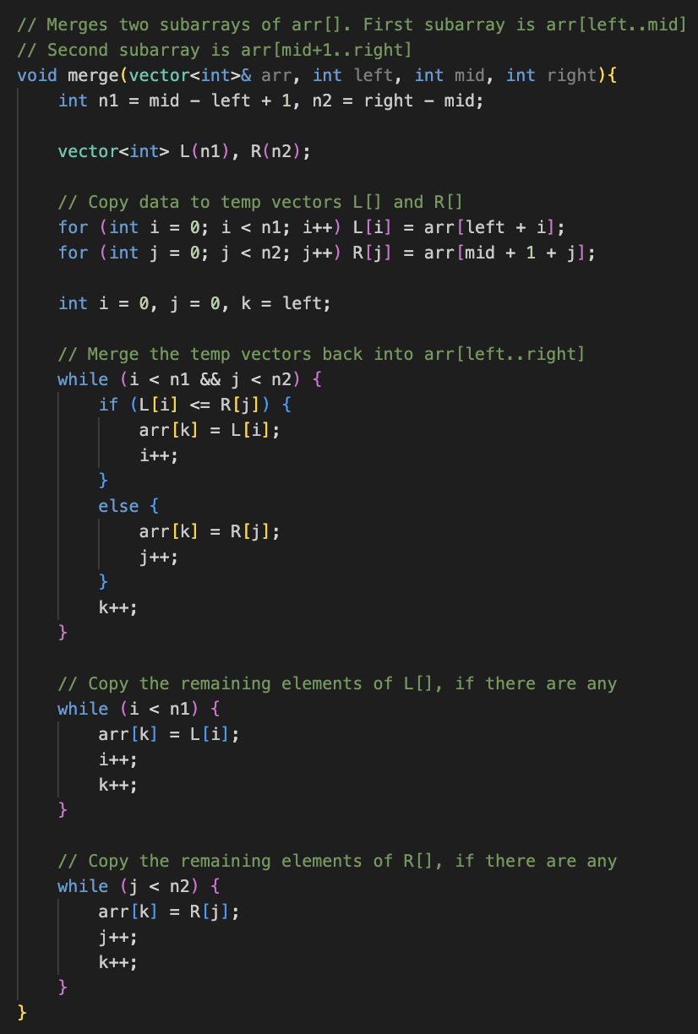
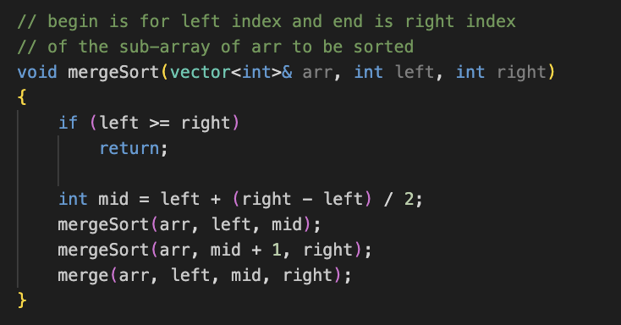
Merge Sort

Slide 15
Quick Sort
Approach:
Choose a pivot element.
Partition the list into elements less than the pivot and elements greater than the pivot.
Recursively sort the partitions.
Time Complexity:
Best Case: O(n log n)
Average Case: O(n log n)
Worst Case: O(n²) (if pivot selection is poor)
Space Complexity: O(log n) (due to recursion stack)

Slide 16
Quick Sort

Slide 17
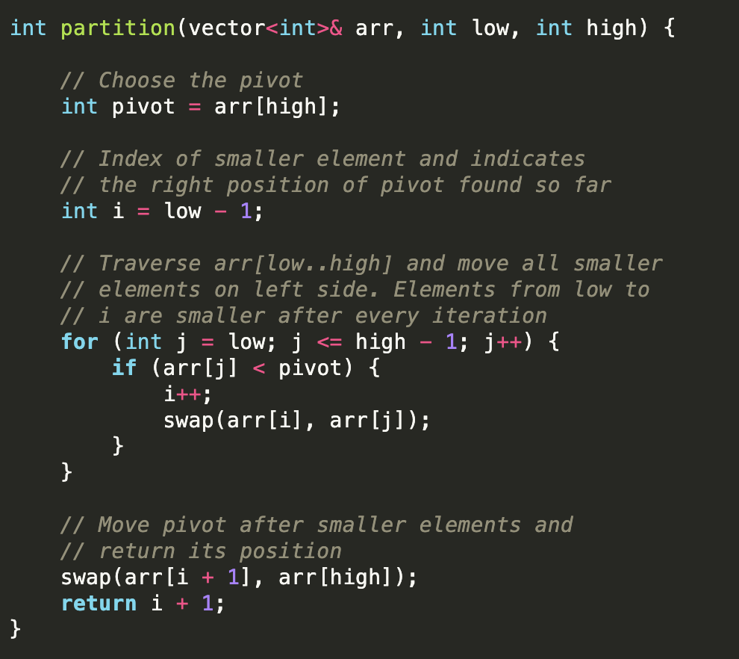
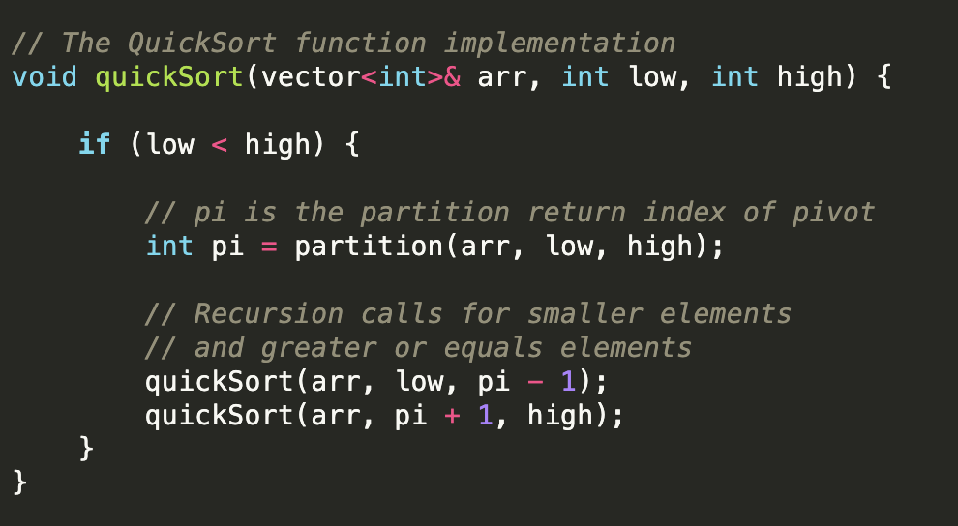
Quick Sort

Slide 18
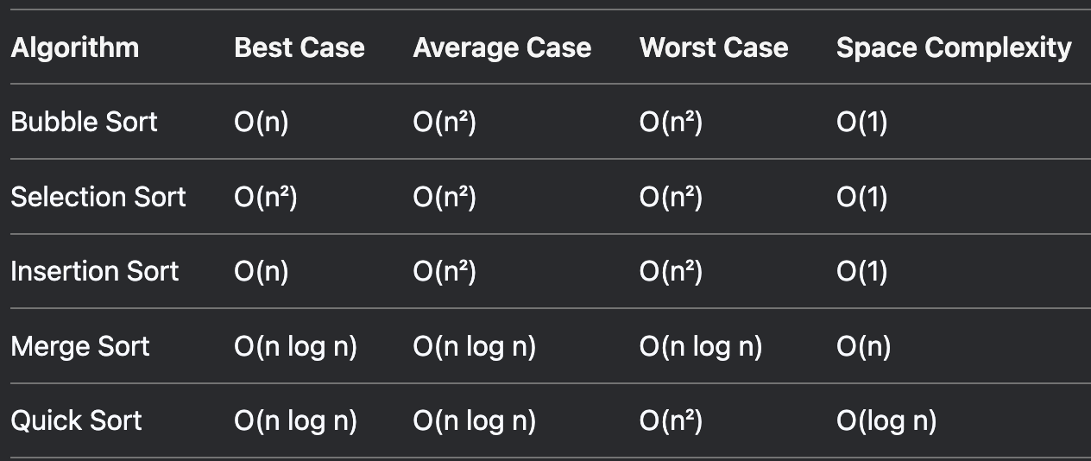

Complexity Comaprison

Slide 19
Complexity Comaprison

Slide 20
Quiz Time!

Slide 21
Q1) If an array is almost sorted, which algorithm is best to use? Why?

Slide 22
Answer
Insertion Sort is optimal for almost sorted arrays.
Why? Its best case is O(n) when the array is nearly sorted because it only shifts out-of-place elements.
Other algorithms like Merge Sort or Quick Sort will still run in O(n log n).

Slide 23
Q2) In Quick Sort, what happens if you always pick the first element as pivot, and the array is already sorted? What’s the time complexity?

Slide 24
Answer
This is Quick Sort’s worst case.
Each pivot leaves one empty partition and one of size n-1.
Becomes O(n²) time.
Fix: Use randomized Quick Sort or pick the middle/median element as pivot.

Slide 25
Q4) If an array is reverse sorted, which algorithms will hit their worst-case performance, and which might not be affected much?

Slide 26
Answer
Worst case:
Insertion Sort: O(n²)
Bubble Sort: O(n²)
Quick Sort: O(n²) if poor pivot choice (like first element)
Not much affected:
Merge Sort: Always O(n log n)

Slide 27
Q5) Why is Merge Sort preferred over Quick Sort when sorting linked lists?

Slide 28
Answer
Merge Sort is preferred because:
Linked lists have no random access.
Merge Sort splits & merges in O(1) extra space using pointers.
Quick Sort needs random access for partitioning—inefficient for linked lists.

Slide 29
Kth Largest Element (LeetCode 215)
Given an integer array nums and an integer k, return the kth largest element in the array. The kth largest element is the element that would be in position len(nums) - k if the array were sorted in descending order.
Example:
Input 1: nums = [3,2,1,5,6,4], k = 2
Output 1: 5
Input 2: nums = [3,2,3,1,2,4,5,5,6], k = 4
Output 2: 4

Slide 30
Approach 1: Full Sort
Sort array in descending order.
Return nums[k-1].
Easy but O(n log n).

Slide 31
Approach 2: Min Heap
Build a min-heap of size k. Push each element:
If heap > k, pop smallest. The top of heap is the kth largest.
Time: O(n log k). Space: O(k).

Slide 32
Median of 2d Array
Given a 2D array of integers, find its median value.
Example:
Input: 1 6 5
2 4 6
7 22 9
Output: 6

Slide 33
Median of 2d Array
Solution
Flatten the 2d array
Sort the array
Locate the median
Complexity
Time: O((m*n)log(m*n))
Space: O(m*n)

Slide 34
Median of 2d Array II
Given a 2D array of integers with sorted rows, find its median value.
Example:
Input: 1 3 5
3 6 8
2 6 9
Output: 6

Slide 35
Median of 2d Array II – Approach 1
Solution
Use Min-Heap
Start by inserting the first element of each row into the heap
Repeatedly extract the smallest element and push the next element from the same row
This continues until reaching the median position
Complexity
Time: O(n*m*log(n)) since we are going to insert and remove the top element in priority queue (n × m) / 2 times
Space: O(n)

Slide 36
Median of 2d Array II – Approach 2
Solution
Use binary search across the value range (from the minimum element to the maximum element in the matrix).
For each guess (mid value), count how many elements in the matrix are less than or equal to mid using binary search on each row.
Narrow the search range until finding the smallest value for which the count is at least half the total elements plus one (the median’s position)
Complexity
Time: O(n*log(m)*log(maxVal -minVal))
Space: O(1)

Slide 37
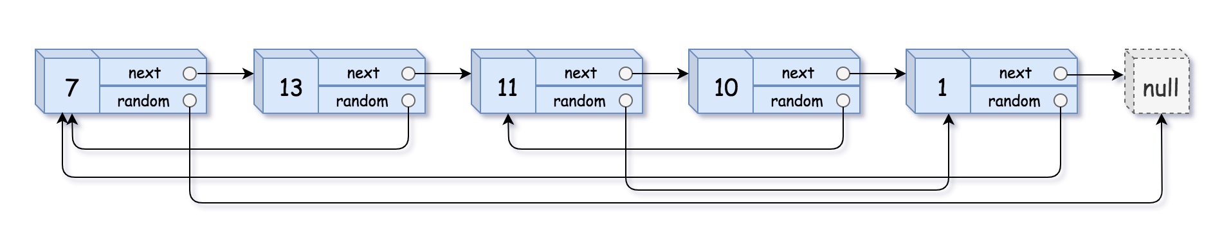
Clone linked list with random pointer
Given a linked list where each node has two pointers:
next: (points to the next node)
random: (points to any node in the list or null)
Create an exact deep copy of the list (cloned nodes and exact same random and next structure).

Slide 38
Clone linked list with random pointer – Approach 1
Solution
Create a hash table, say mp to store the new nodes corresponding to their original nodes.
Traverse the original linked list and for every node, say curr, => Create a new node corresponding to curr and push them into a hash table, mp[curr] = new Node().
Again traverse the original linked list to update the next and random pointer of each new node, mp[curr]->next = mp[curr->next] and mp[curr]->random = mp[curr->random].
Return mp[head] as the head of the cloned linked list.
Complexity:
Time: O(2n)
Space: O(n)

Slide 39
Clone linked list with random pointer – Approach 2
Solution
Iterate the original list and duplicate each node. The duplicate of each node follows its original immediately.
Iterate the new list and assign the random pointer for each duplicated node.
Restore the original list and extract the duplicated nodes.
Complexity:
Time: O(3n)
Space: O(1)

Slide 40
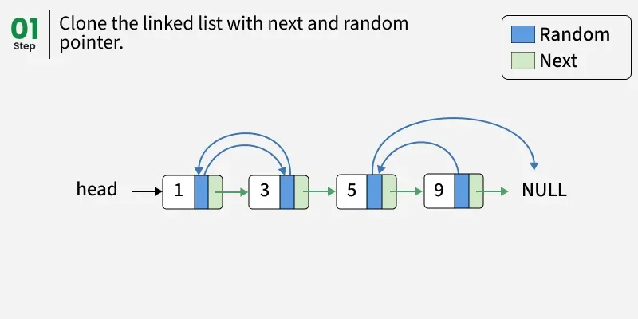

Slide 41
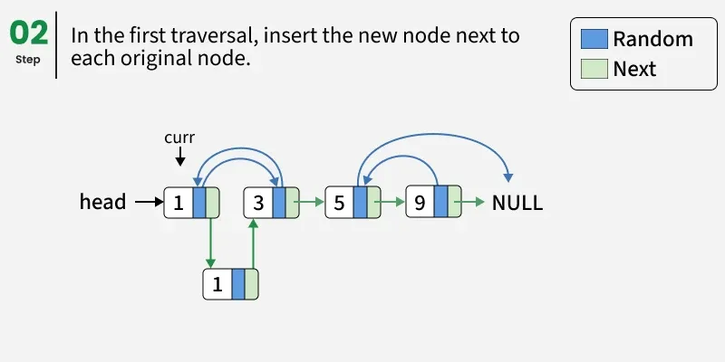

Slide 42
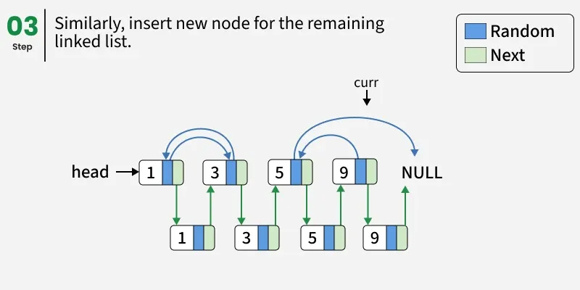

Slide 43
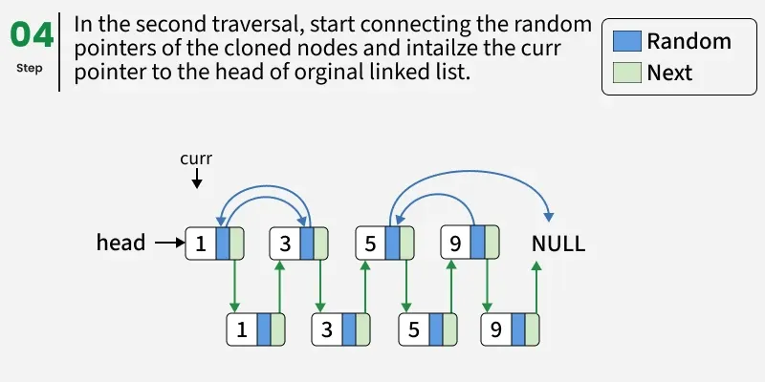

Slide 44
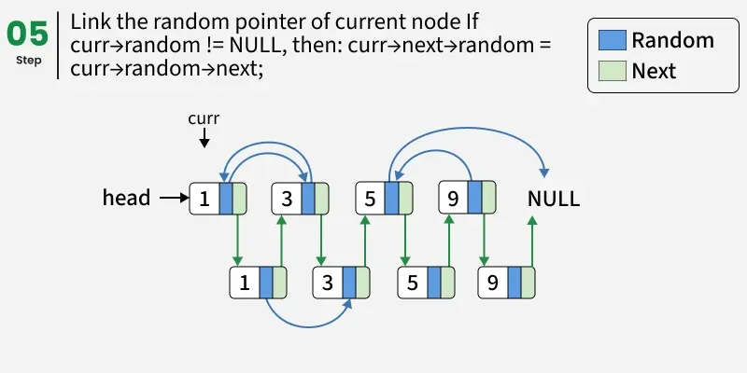

Slide 45
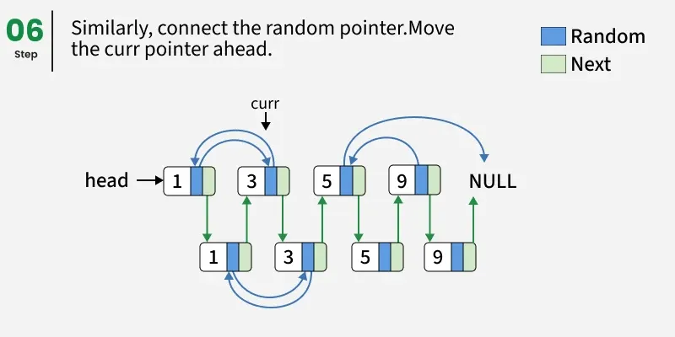

Slide 46
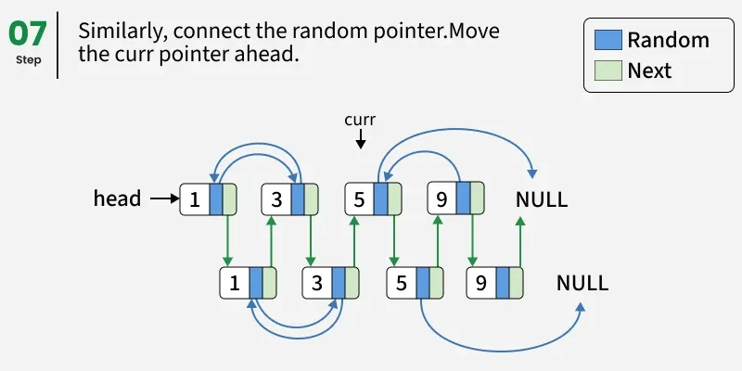

Slide 47
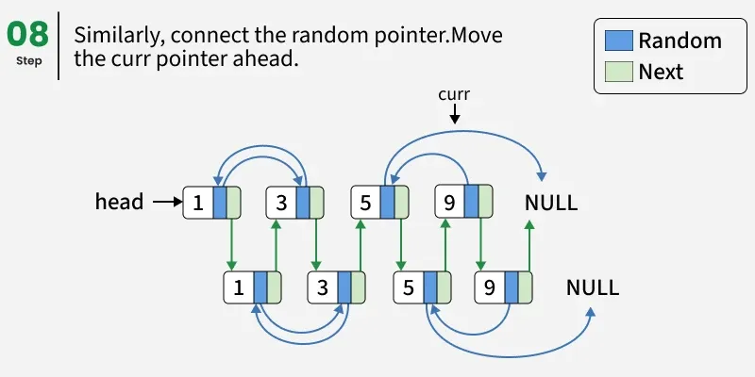

Slide 48
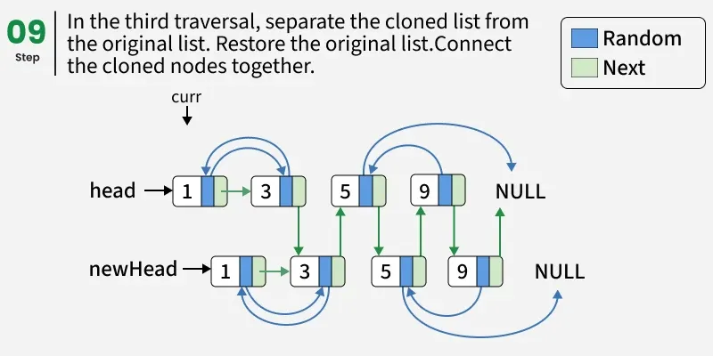

Slide 49
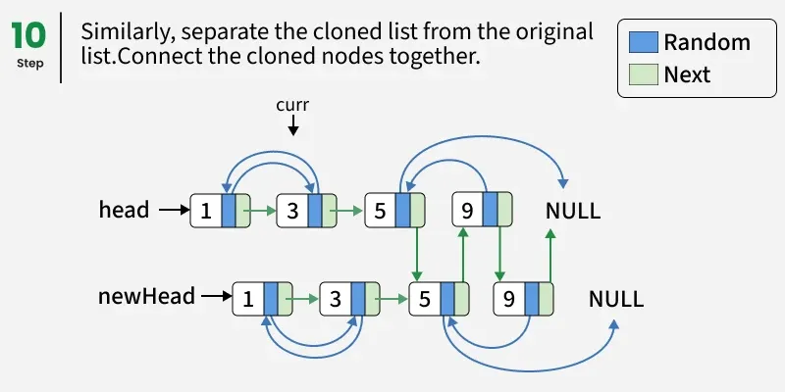

Slide 50
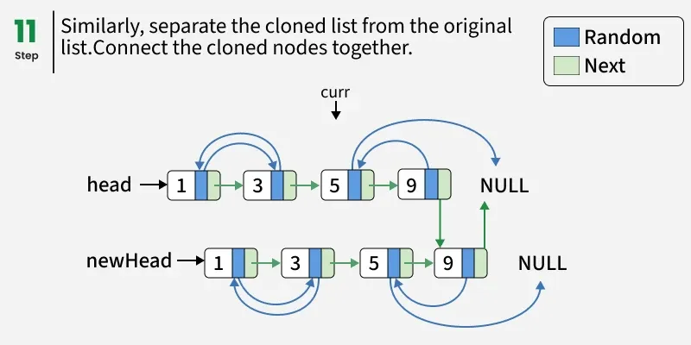

Slide 51
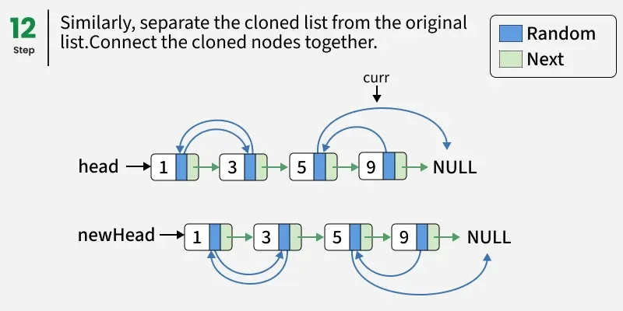

Slide 52
Group Activity Time!

Slide 53
Design a hybrid sorting algorithm

